Slide 1
A GENERALIZED PIPELINE CELLULAR ARRAY
Pipeline Cellular Array

Slide 2
Generalized Addition, Subtraction, Multiplication, Division, Squaring and Square-rooting of Binary numbers
This is a pipelined type of approach
Since it is an array, it is convenient for VLSI design
Pipeline Cellular Array

Slide 3
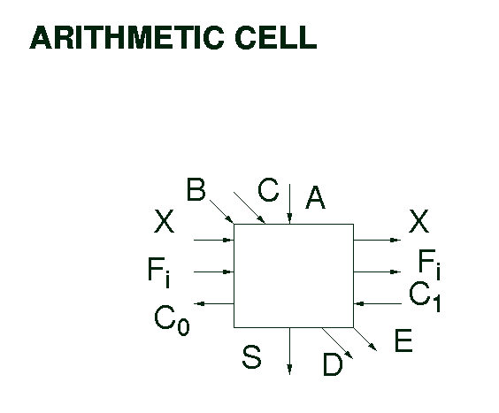
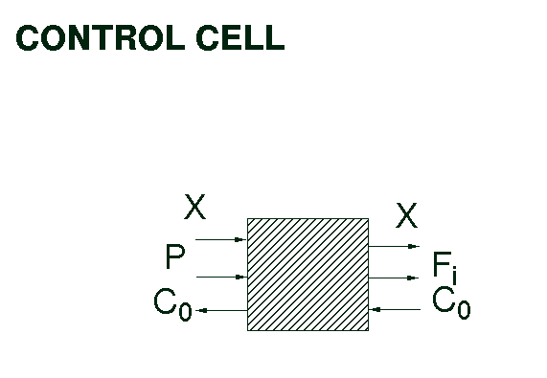
Basic Cells
Arithmetic Cell Control Cell
Pipeline Cellular Array

Slide 4
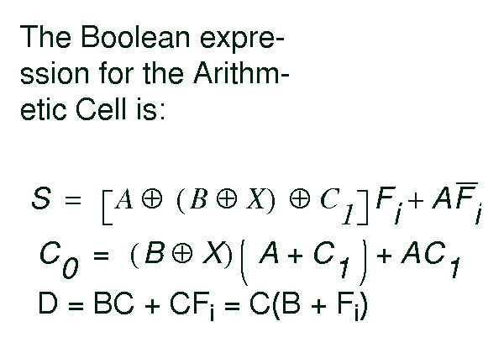
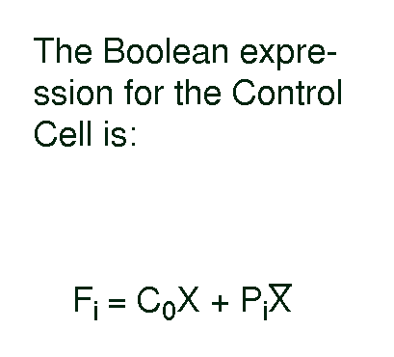
The Boolean Expressions for Arithmetic Cell:
The Boolean Expressions for Control Cell:
Pipeline Cellular Array

Slide 5
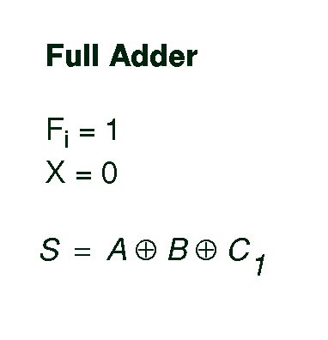
Pipeline Cellular Array

Slide 6
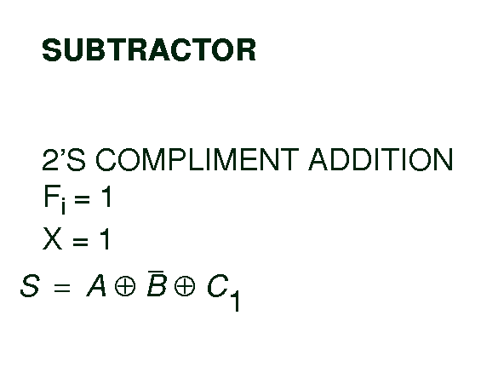
Pipeline Cellular Array

Slide 7
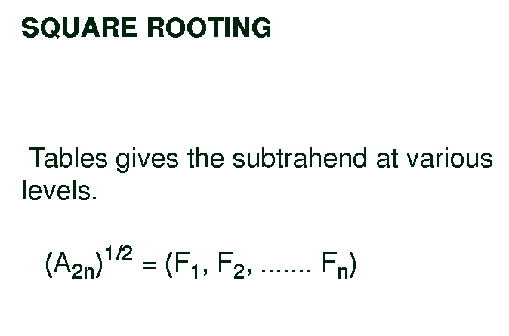
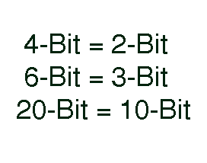
Note that, the square root of:
Pipeline Cellular Array

Slide 8
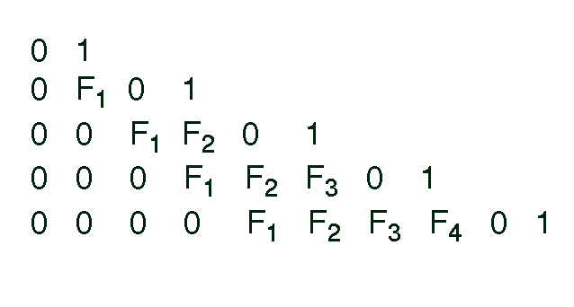
Square Rooting:
Pipeline Cellular Array

Slide 9
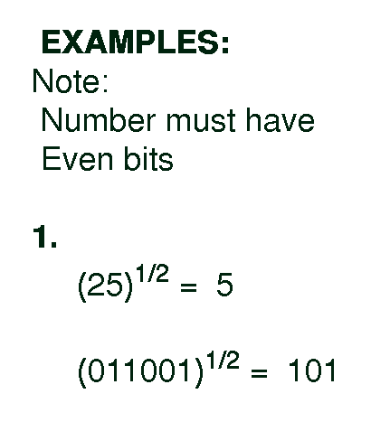
Examples: Find the square root of:
Pipeline Cellular Array

Slide 10
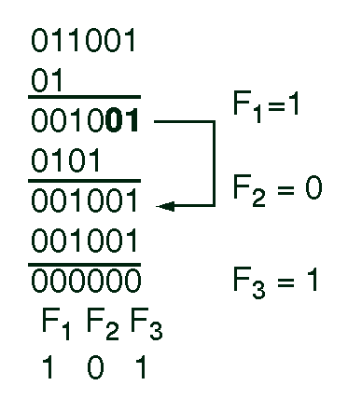
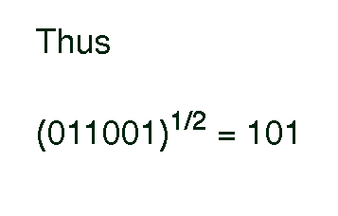
Square root of 25:
Pipeline Cellular Array

Slide 11
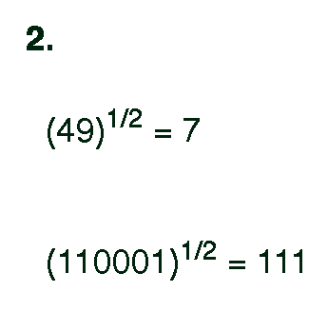
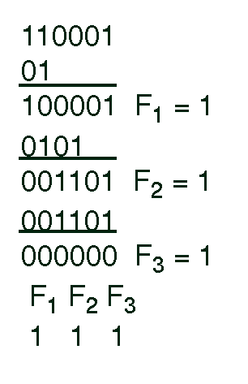
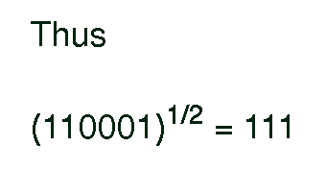
2.
Pipeline Cellular Array

Slide 12
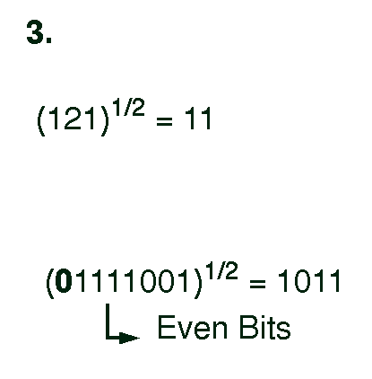
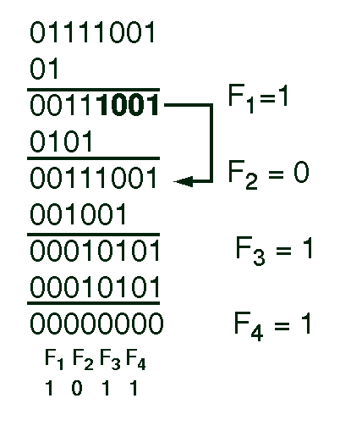
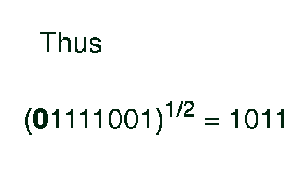
3.
Pipeline Cellular Array

Slide 13
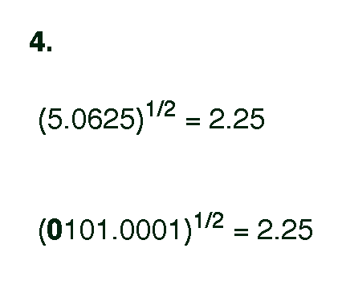
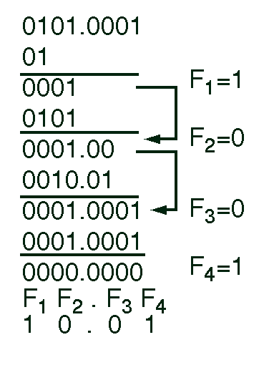
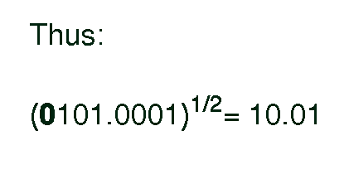
4.
Pipeline Cellular Array

Slide 14
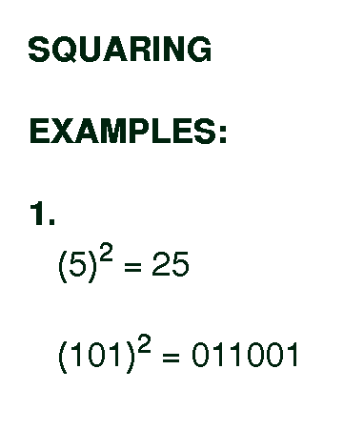
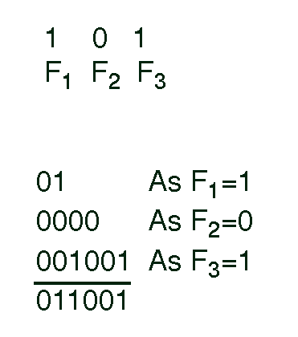
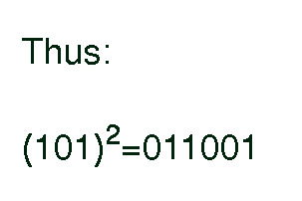
Squaring Examples
Pipeline Cellular Array

Slide 15
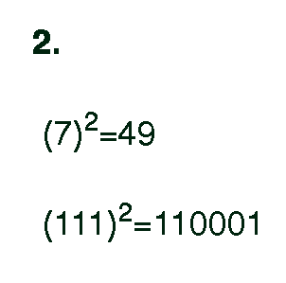
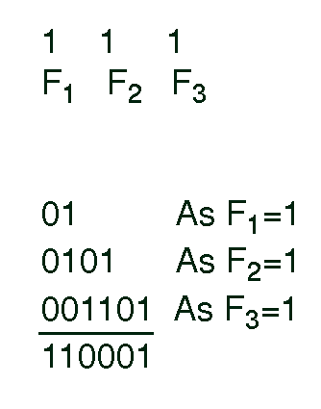
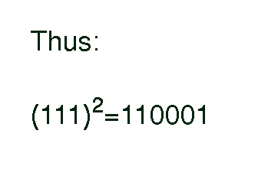
Pipeline Cellular Array

Slide 16
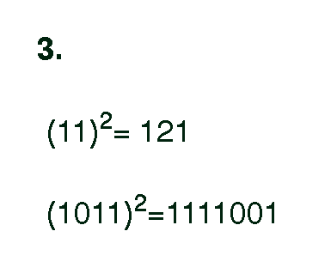
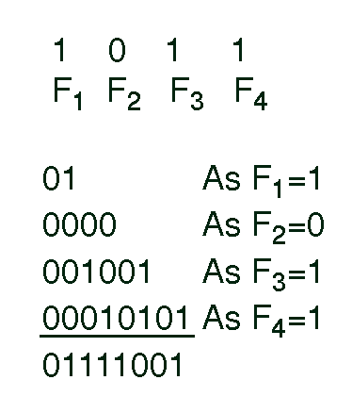
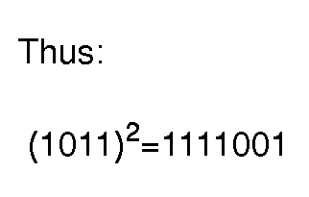
3.
Pipeline Cellular Array

Slide 17
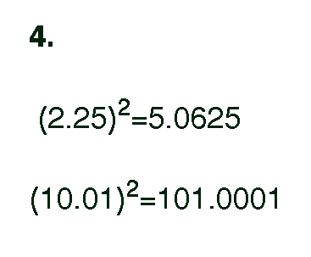
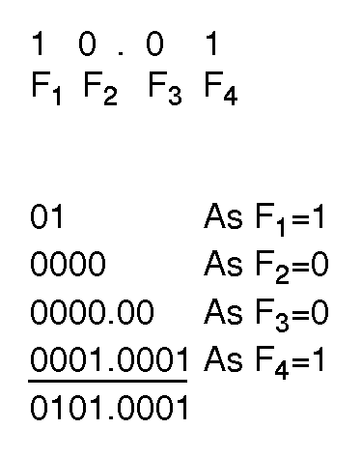
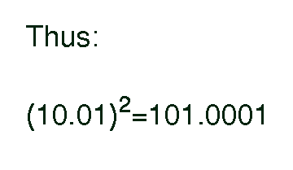
4.
Pipeline Cellular Array

Slide 18
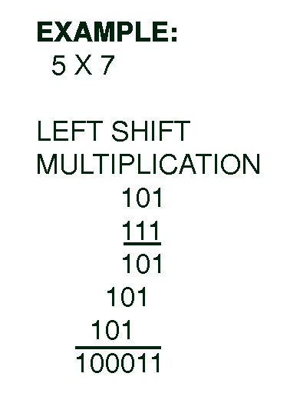
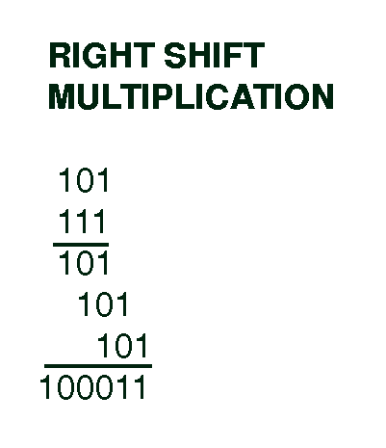
Multiplication
In Multiplication, RIGHT SHIFT MULTIPLICATION method
is used instead of LEFT SHIFT MULTIPLICATION method
Example: 5 X 7
LEFT SHIFT MULTIPLICATION RIGHT SHIFTMULTIPLICATION
Pipeline Cellular Array

Slide 19
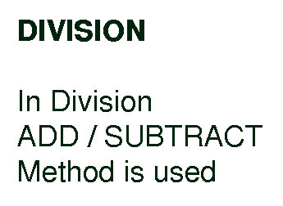
Pipeline Cellular Array

Slide 20
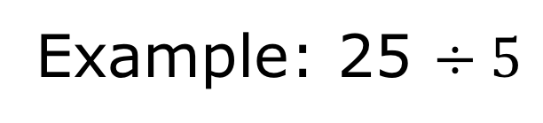
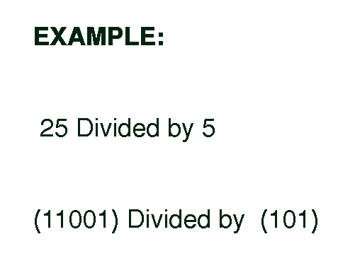
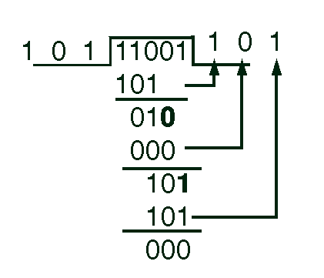
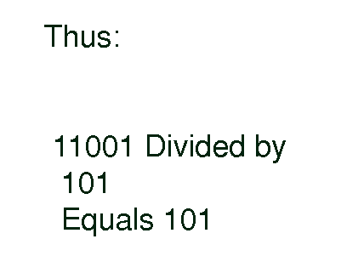
Pipeline Cellular Array

Slide 21
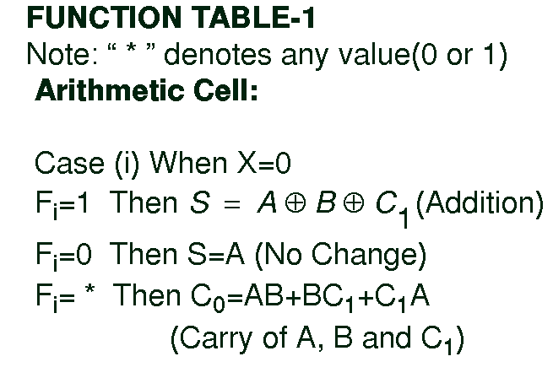
Pipeline Cellular Array

Slide 22
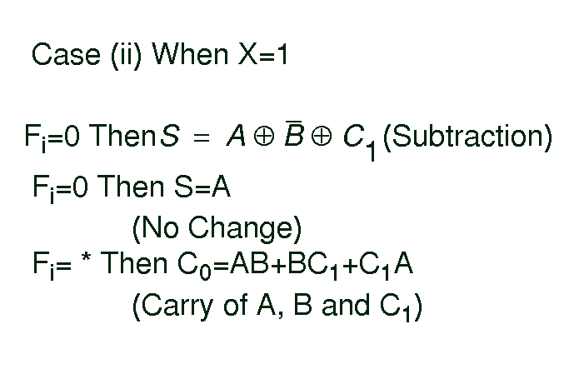
Pipeline Cellular Array

Slide 23
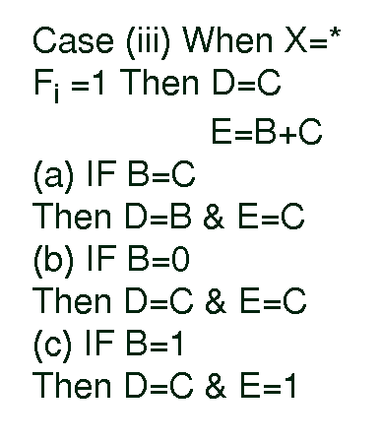
Pipeline Cellular Array

Slide 24
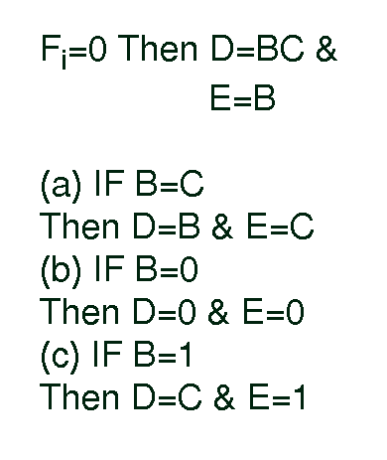
Pipeline Cellular Array

Slide 25
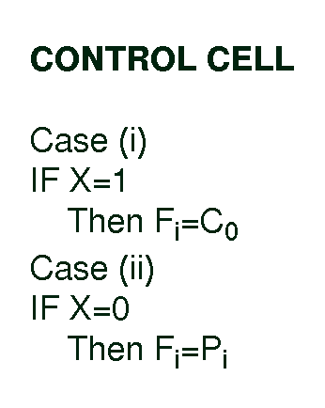
Pipeline Cellular Array

Slide 26
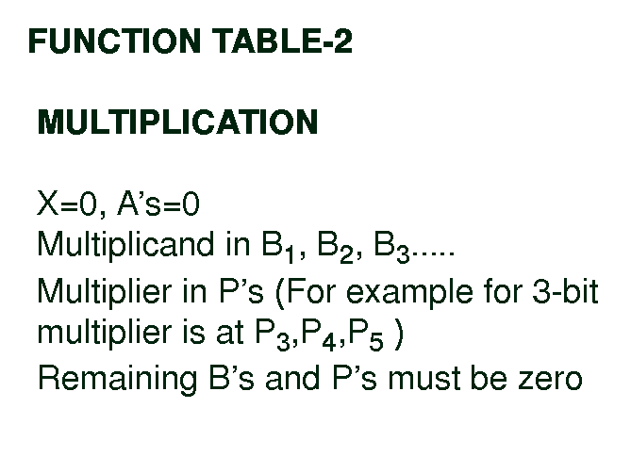
Pipeline Cellular Array

Slide 27
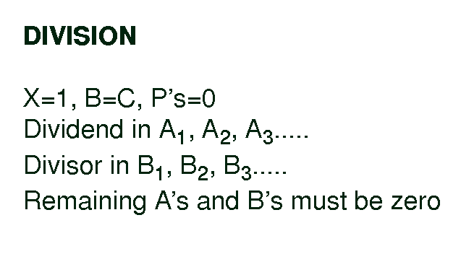
Pipeline Cellular Array

Slide 28
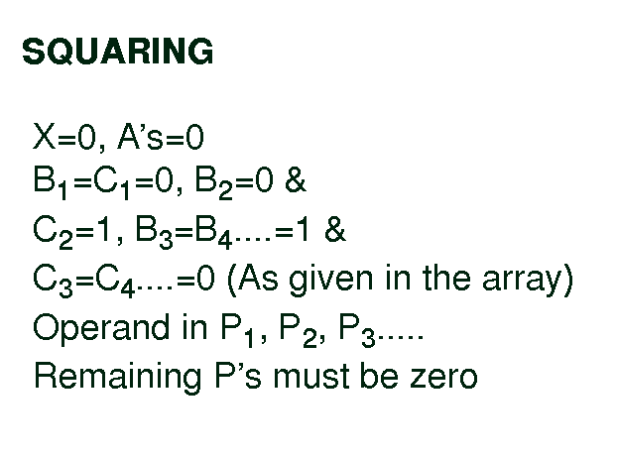
Pipeline Cellular Array

Slide 29
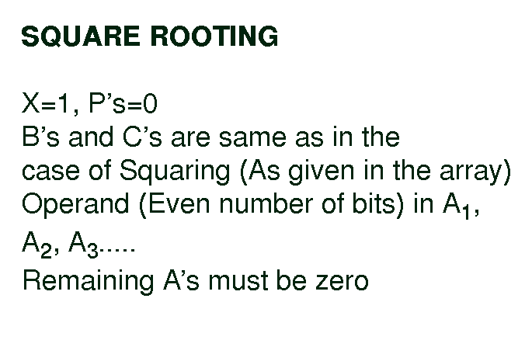
Pipeline Cellular Array

Slide 30
Note that in case of Binary numbers with Binary point, we first ignore the Binary point while feeding it on pipeline array. Finally, we add the Binary point at appropriate position depending upon the computation
Pipeline Cellular Array

Slide 31
General Procedure for Doing Computation
on Pipeline Array
Propogate X
Calculate C_{o}
Calculate F_{i}
Finally compute D, E, and S
Pipeline Cellular Array

Slide 32
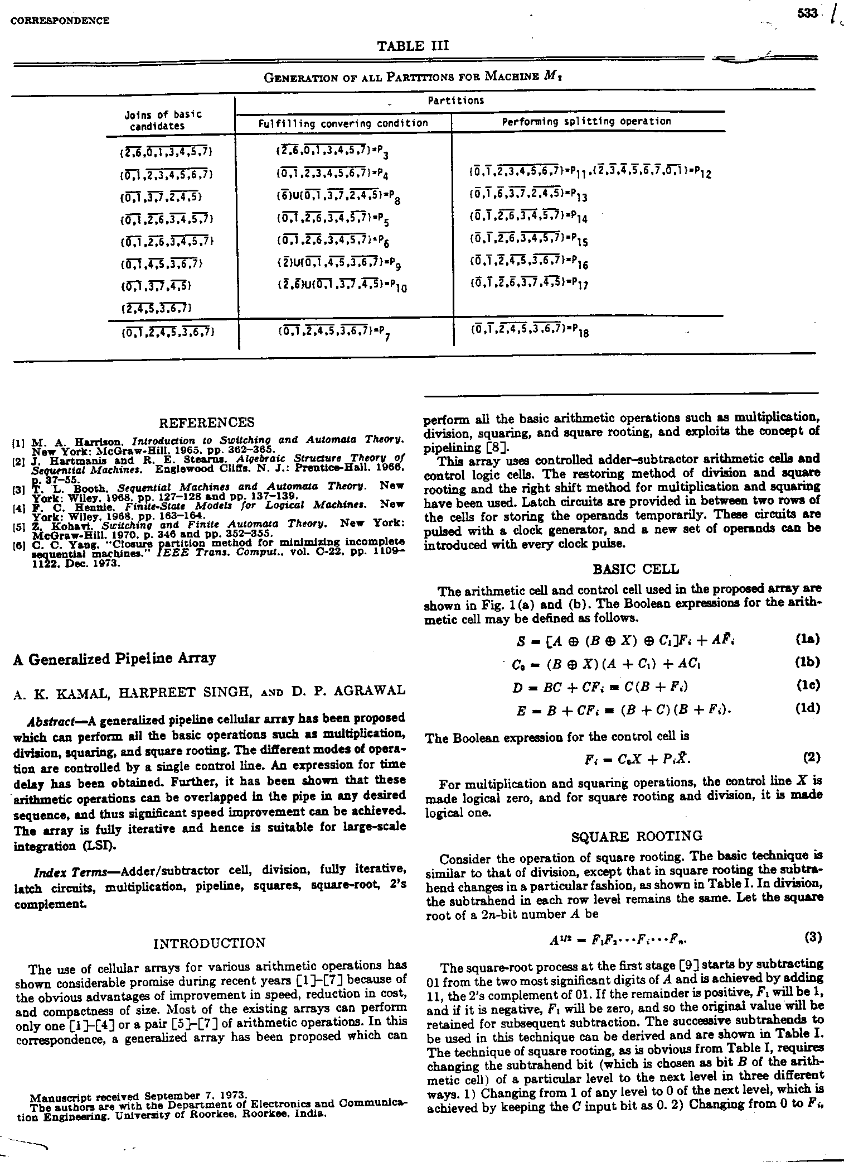
Pipeline Cellular Array

Slide 33

Pipeline Cellular Array

Slide 34

Pipeline Cellular Array

Slide 35

Pipeline Cellular Array

Slide 36

Pipeline Cellular Array

Slide 37

Pipeline Cellular Array

Slide 38

Pipeline Cellular Array

Slide 39

Pipeline Cellular Array

Slide 40

Pipeline Cellular Array

Slide 41

Pipeline Cellular Array

Slide 42

Pipeline Cellular Array

Slide 43

Pipeline Cellular Array

Slide 44

Pipeline Cellular Array

Slide 45

Pipeline Cellular Array

Slide 46

Pipeline Cellular Array

Slide 47

Pipeline Cellular Array

Slide 48

Questions?
Pipeline Cellular Array

